Slide 1

H
S
Team 3
Brianna Baird Christina Canady Kelsey Cox
Arianna DeNardo Luke Jarrell
AIR
ALON
S
&
PA
MIS 4123

Slide 2

PROJECT SCOPE
Examine and analyze current network system
Run a security assessment and audit of current system
Provide suggested improvements to ensure better performance and security

Slide 3

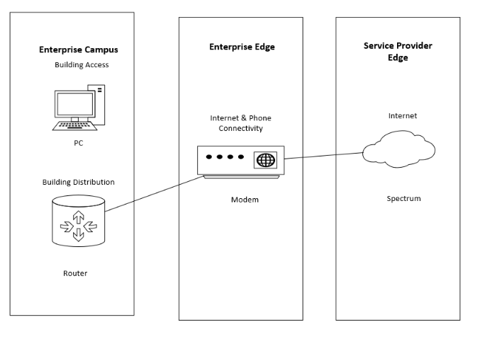
ENTERPRISE
NETWORK DIAGRAM
Enterprise Campus
Building Access (LAN)
Building Distribution(Wi-Fi)
Enterprise Edge
Internet Connectivity
Service Provider Edge
Spectrum

Slide 4


NEEDS ASSESSMENT
Identified three main areas for improvement based on needs assessment:
Training employees on basic security principles
Purchase and utilize firewall security
Improving WAP placement
Utilizing Carbonite services for Disaster Recovery

Slide 5

RISK ASSESSMENT
These risk scenarios were identified:
Customer financial data
Employee devices (computers, mobile phones, etc.)
Internet access
Natural Disaster
Physical location/ Security monitoring tools
Transaction Processing System

Slide 6
GAP ANALYSIS
Better Wi-Fi Coverage:
Weak signal where clients and stylists are located.
Access point positioned furthest from high-traffic areas.
Below-average Wi-Fi signal in front of the salon.
Establish Network Security:
Current lack of network security is a pressing issue.
Industry standard includes antivirus and network firewall, both absent at Tanglez.
Vulnerability to cybersecurity attacks without proper security measures.
Employee Training:
Industry standard involves minimal training in basic security principles.
Training in phishing, social engineering, and malware/hacking defense is crucial.
Offers significant security improvements at minimal cost.
Data Loss Prevention:
Absence of data loss prevention measures at Tanglez.
Implementation of software such as Carbonite recommended.
Industry standard to have data loss prevention for disaster recovery, saving time and money.

Slide 7
SWOT ANALYSIS
INTERNAL FACTORS
STRENGTHS + | WEAKNESSES –
Family-owned business Proactive business operations Credibility of management Staff is technologically literate | No formal oversight or responsibility over network Wi-fi coverage is spotty No business continuity or disaster recovery plans User knowledge Network security gaps No data loss prevention
EXTERNAL FACTORS
OPPORTUNITIES + | THREATS –
Better Wi-Fi signal throughout salon Moving data to cloud environment Cross-training coaching Utilizing this free analysis | Natural disasters Malware, ransomware Social engineering and phishing attacks Data loss Unauthorized access to restricted information

Slide 8
RECOMMENDATIONS
Establish Firewalls and Access Controls:
Priority: Urgent
Implement firewalls and access controls for customer data, financial records, and employee devices.
Secure financial data and records to maintain confidentiality.
Keep Hardware and Software Updated:
Patch vulnerabilities and strengthen security.
Ensure all hardware and software are regularly updated to mitigate risks.
Install Monitoring and Prevention Measures:
Set up cameras for monitoring and prevention.
Implement a full security system for the building, including alarms and keypad entry.
Implement Fire Detection and Prevention Measures:
Lower the risk of natural disasters by installing fire detection and prevention measures.
Establish Physical Security Controls:
Create and enforce controls and locks to safeguard physical assets and sensitive areas.
Implement Backup Systems:
Avoid data loss and ensure business continuity by establishing backup systems.
Backup systems are crucial in case of disasters to maintain operations.
Comprehensive Employee Training:
Provide comprehensive training to employees on cybersecurity best practices.
Cover topics such as phishing, social engineering, and malware defense.
Raise awareness of security protocols and the importance of maintaining a secure network environment.

Slide 9
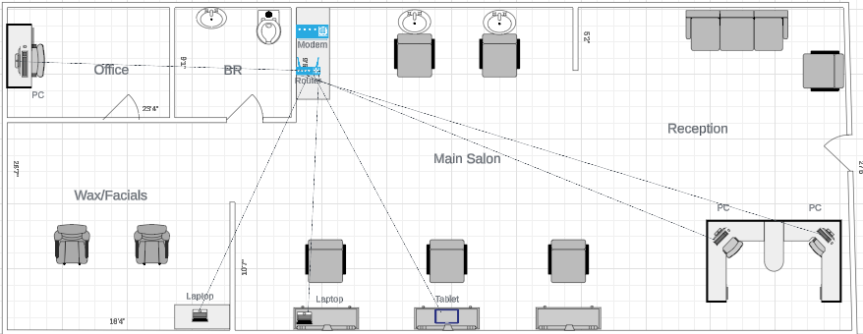
UPDATED PHYSICAL NETWORK DIAGRAM
relocation of the modem and router from the back office and the addition of a table/cabinet near the washing stations
strength of the internet signal will be better for the PCs and tablet near the front of the salon with minimal effect on the devices in the office

Slide 10
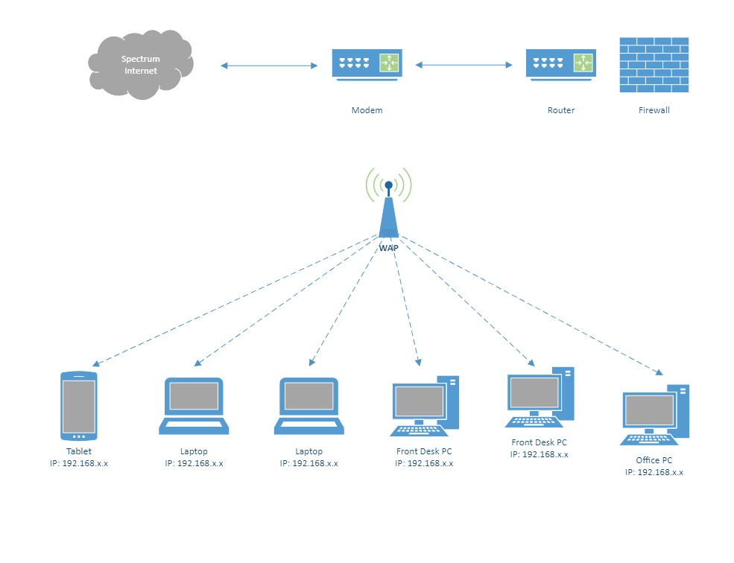
UPDATED LOGICAL NETWORK
DIAGRAM

Slide 11

BUDGET
Item | Yearly Cost | Benefit | Comments
SonicWall TZ370 | 1825.00 | Protects from cyberattacks, controls unwanted websites, filters traffic in and out of network
Antivirus | 99.99/5 devices | Protects from malware, trojans, ransomware | Many types, suggested is AVG antivirus business edition
Wireless Access Point | 200$ | Better connectivity throughout salon | Optionally, the current router that functions as a WAP can be moved to a more centralized lcoation
Employee Training | 0$ | Employees are better prepared to defend company from cybersecurity attacks | Can be found free on LinkedIn
Carbonite | 599$ | Data backups in the event of disaster
Total: 2723.99

Slide 12
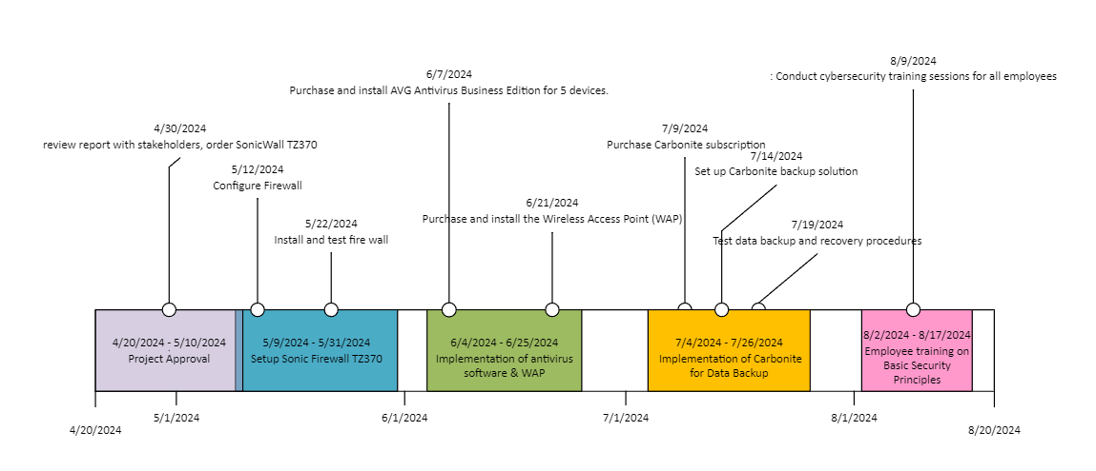
MIGRATION PLAN

Slide 13
DISASTER RECOVERY PLAN
Step One: Put together a team of employees with at least one member being technologically literate.
Step Two: Set clear RTO’s and RPO’s. The RTO (recovery time objective) is the length of time an application can be down before business is negatively impacted. An RPO (recovery point objective) is the most data that can be lost before business is significantly harmed.
Step Three: Take a detailed inventory of all hardware and software being used as well as any asset in the organization’s possession. This is a crucial step because you want to prioritize this list in the event of a disaster.
Step Four: Outline roles and responsibilities for all members of the team. Create a call sheet with everyone’s contact information along with their role and responsibilities within the group.
Step Five: Document a recovery strategy. This should include how to access data backups, communication procedures and post-disaster activities.
Step Six: Create a crisis communication plan. This is where public relations would get involved if they are present. Be sure to have a clear strategy to keep stakeholders informed and up to date with what is happening.
Step Seven: Test all plans! Update plans with necessary revisions if needed.

Slide 14
CYBERSECURITY PLAN
To be prepared for a cyberattack we have created a cybersecurity plan to implement, the plan consists of steps and procedures to ensure the security of Salon. Those steps include:
Knowing the risks: Understanding what could go wrong and how to properly protect your data
Teach your team: Teach staff how to target threats and prepare them to deal with these situations
Keeping Updated: Ensure technology has up-to-date security fixes
Backing up data: Have copies of important information on site in case something goes wrong
Keep learning: Stay up to date on new ways to keep the salon safe from hackers

Slide 15
CONCLUSION & NEXT STEPS
We chose to move the modem and router to a more centralized location in the salon to increase connectivity and signal. With a small investment in protective software measures, the salon can ensure that no one breaches their customer data from the outside.
We have made recommendations and plans that would help improve performance, efficiency, and security measures. These include a wireless access point, a Carbonite data backup system, antivirus software, and basic employee training to lessen the risk of cybersecurity attacks. Changing default credentials, setting up a separate guest network, and using strong passwords will also improve their network posture and protect accessible client data.
Only authorized users, such as employees and the owner, can access this information. We believe that these changes will help the salon in the long run by making customers feel more comfortable knowing that the salon is protecting their information and can be trusted with it.

